Slide 1
Blockchain interoperability
———
Cross-chain oracles with
Decentralized Computing
Matthieu BETTINGER

Slide 2
Summary
Context & Motivation
State of the Art
Proposed solutions
Results & Evaluation
Conclusion & Future work

Slide 3
Context & Motivation
Oracles
Blockchain trilemma:
Decentralization
Scalability
Security

Slide 4
Context & Motivation
Generic oracle use-cases
  Data queries (request-handling)
  Triggers (event-handling)
  Cross-chain calls → Cross-chain smart contracts
→ Cross-chain oracles

Slide 5
Context & Motivation
Variety of use-cases and non-functional requirements by end-users
  For blockchain systems
  For oracle systems
→ Use of decentralized cloud computing infrastructures for flexibility

Slide 6
State of the Art
Datafeeds
+
–

Slide 7
State of the Art
Cross-chain bridges
+
–

Slide 8
State of the Art
Decentralized cloud computing infrastructures
+
–

Slide 9
Research questions
Secure data transfers using DCCIs
  data integrity, on/off-chain verifiability
Flexibility of oracle system properties
  data acceptance, scalability, decentralization
Cost reduction strategies

Slide 10
Building blocks :
Trusted Execution Environments (Intel SGX)

Slide 11
Building blocks : iExec Decentralized Cloud Computing

Slide 12
Proposal 1: Proxy tasks
+ Code & Data integrity: TEE to securely generate & transfer results
+ Cost reduction:
  → Blockchain trust algorithm (PoCo) delegated on a fast and cheap chain
  → Storage reduction: Only results and traceability metadata stored on the costly chain
Inherited from iExec infrastructure:
– Usability; Storage costs: Inefficient untyped blob storage for results
– Reactivity; Throughput: Single result per task

Slide 13
Proposal 1: Proxy tasks
Workflow

Slide 14
Proposal 2: Work passes
Protocol properties
+ Reactivity; Throughput: Multiple results per dApp execution
+ Flexible security: Consumer-defined data acceptance logic
+ Usability; Storage costs : Application-specific typed storage
– Security risk: Direct access to consumer methods
  → Intermediate dApp-specific storage as buffer
– Storage costs: A pass per consumer contract

Slide 15
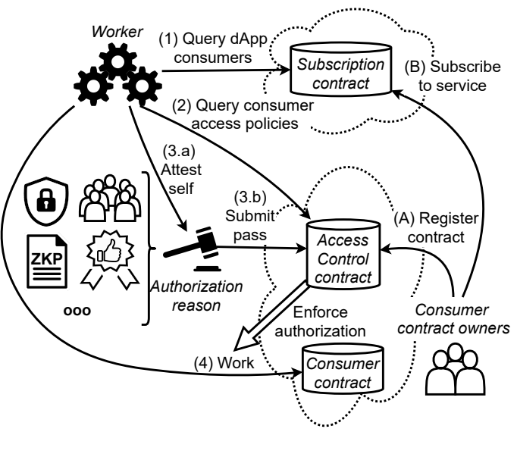
Proposal 2: Work passes
Workflow
Authorization reason
  Attested TEE
  Committee consensus
  (ZK) Proof
  Trusted identity
  ...

Slide 16
Proposal 2: Work passes
Protocol optimizations
One-time passes
  + No persistent storage costs
  – Repeated authorization verification
Per-dApp passes
  + Only one pass per worker per dApp per chain
  – Additional storage costs + pass linking costs

Slide 17
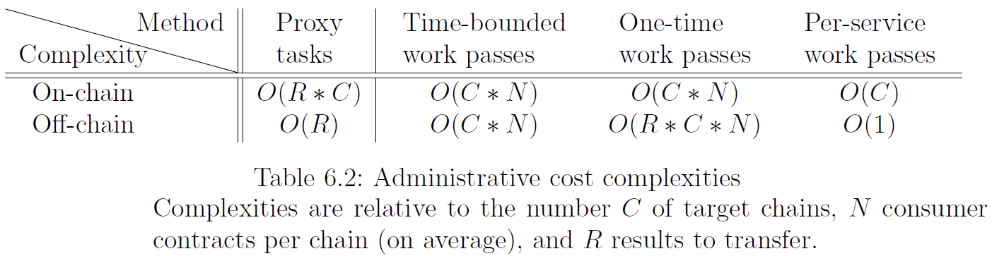
Results :
Algorithmic complexities

Slide 18
Results:
General Metrics
Full PoCo task execution with TEE worker :
  → ~5 minutes of non-productive processing
Proxy tasks VS current iExec tasks :
  → –64 % gas costs

Slide 19
Results:
General Metrics
Work passes VS current iExec tasks :
  1 result ; 1 consumer : –53 %
  Worst case (1 result ; Inf consumers) : +130 %
  Best case (Inf results ; 1 consumer) : –88 %

Slide 20
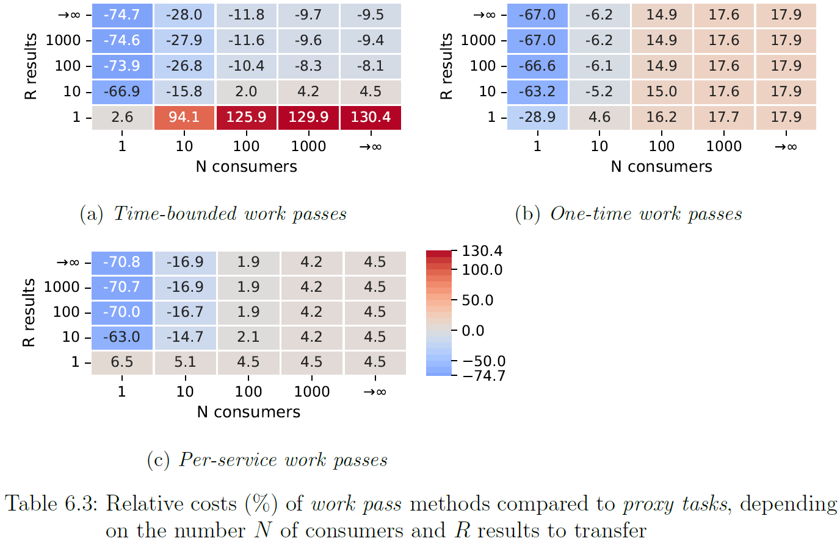
Results:
Scaling costs

Slide 21
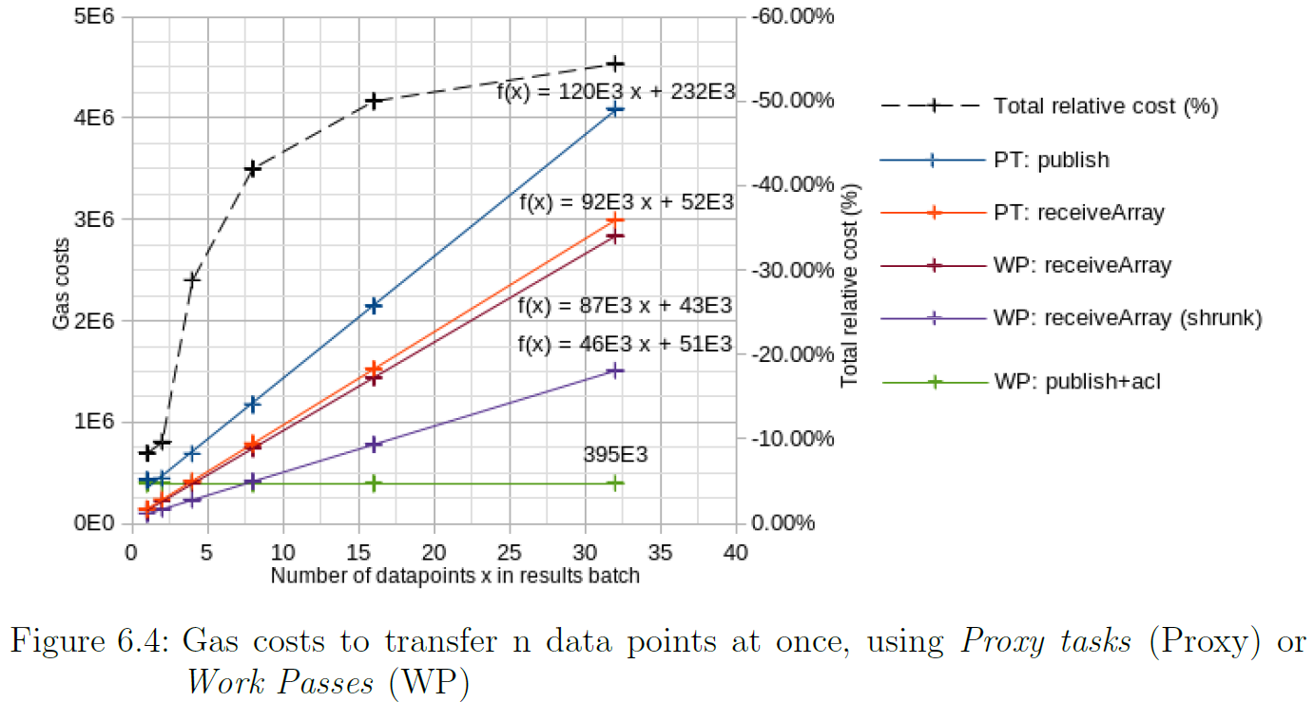
Results:
Impact of N-Batching

Slide 22
Conclusion
Reuse of trusted security mechanisms
Less storage and processing on costly blockchains
More genericity:
  Data acceptance mechanisms
  Result size and number

Slide 23
Future work
Scalability stress tests
dApp modularity/composability
New data acceptance mechanisms
  Streamed result consensus

